Slide 1
Building upon CALI Curriculum Materials for Increased Performance Assessment
Joel Chanvisanuruk
Director, Programs for Academic and Bar Success
AccessLex Center for Legal Education Excellence ®
Notes:
Cover picture should change to reflect PPT Topic. TM Icon at top can be replaced with partner logo (Right click, change picture select partners logo from desktop or clipboard). **If just an AccessLex Presentation delete TM icon**

Slide 2
Agenda
1.
Introduction to AccessLex
2.
LexScholars Post-Baccalaureate Program
3.
Curricular Approach and Demands
4.
Leveraging CALI Materials

Slide 3
AccessLex: Center for Legal Education Excellence
AccessLex Institute® fosters broad-based access to quality legal education for talented, purpose-driven students and works to maximize the value and affordability of a law degree through policy advocacy, research and student-focused initiatives.
Through its academic and bar success programming, outreach, publications, research, and grantmaking, The Center for Legal Education Excellence ® seeks to materially and measurably increase levels of student success in and beyond law school — and improve first-time bar exam passage nationwide.

Slide 4
LexScholars Post-Baccalaureate Program

Slide 5
Program Overview
LexScholars is a diversity pipeline initiative aimed at learning more about effective methods for increasing law school diversity by providing aspiring lawyers with resources and guidance to pursue their goal of attending law school.
LexScholars targets prospective law students from underrepresented racial, ethnic and socioeconomic backgrounds who possess potential for law school success but may be unlikely to gain admission due to unfavorable standardized test scores.

Slide 6
Program Overview
The LexScholars Post-Baccalaureate Program is a deferred admission program that provides law schools with a means of broadening access to legal education to promising applicants who appear to need additional preparation and exposure prior to starting law school.

Slide 7
Program Components
Deferred Admission and 20% scholarship commitment from referring law school
LSAT Prep Course
Law School Prep Coaches
10-month skills and content programming
In-school stipend
Bar Prep Course

Slide 8
Program Demands and Design
Notes:
Will introduce the curriculum materials, assumptions and theory underpinning the Curricular design, examples of how we will engage with the curriculum.

Slide 9
Program Demands
Curriculum will be delivered via synchronous and asynchronous distance learning methods.
All materials need to be remotely accessible.
Scholars will be assessed based on Engagement and Performance.
Needed means to track participant use and performance.

Slide 10
Program Design
The LexScholars Post-Bacc Curriculum focuses on literacy within the domain of law school.
Our overarching goal is to make participants skilled legal readers.*
Skilled legal readers derive meaning from legal texts accurately and efficiently.
*Drawn from Scarborough’s Model of Early Literacy, Scarborough, H. S. (2001). In S. Neuman & D. Dickinson (Eds.), Handbook for research in early literacy (pp. 97–110). New York, NY: Guilford Press.
Notes:
Curriculum focuses on literacy within the domain of law school
Why literacy?
The primary means of acquiring legal knowledge and analysis skills is via written texts.
We’ve heard and used the analogy of studying law is like learning a new language. And this is true. But the method of learning and building skills within law requires skills engaging with the written text of law (e.g. the Langdell method).
Skills gaps will delay a law student becoming a skilled legal reader.

Slide 11
Three Areas of Skills Development and Assessment
Understanding
The accurate recitation of facts and law
Acquiring new vocabulary, both contextual/historical and legal terminology
Interpreting
The accurate recounting of analytical steps
Explaining the process by which an outcome was reached
Application
The accurate alignment of legal rules or principles to provided facts
Demonstrating the ability to identify relevant legal rules and explain the legal significance of facts in support of a conclusion
Notes:
Understanding
Background Knowledge
Domain Vocabulary
Interpreting
Verbal Reasoning

Slide 12
Leveraging CALI Materials
Notes:
Will introduce the curriculum materials, assumptions and theory underpinning the Curricular design, examples of how we will engage with the curriculum.

Slide 13
Partnership with
Casebooks
Torts: Prof. Zahr K. Said, Univ. of Washington School of Law
Criminal Law: Prof. Alice Ristroph, Brooklyn Law School
Contracts: Prof. J. H. Verkerke, Univ. of Virginia School of Law
Interactive Lessons
Sub-topics within Torts, Criminal Law and Contracts
Law School Success Fellows’ Interactive Lessons
Interactive lessons on IRAC, thinking like a lawyer, metacognition, case briefing and note-taking

Slide 14
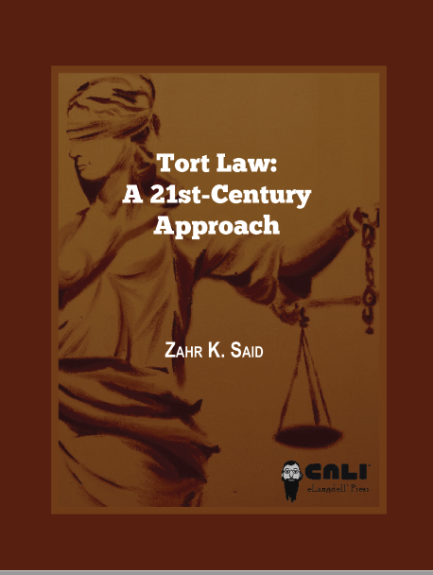
Depth of Casebooks

Slide 15
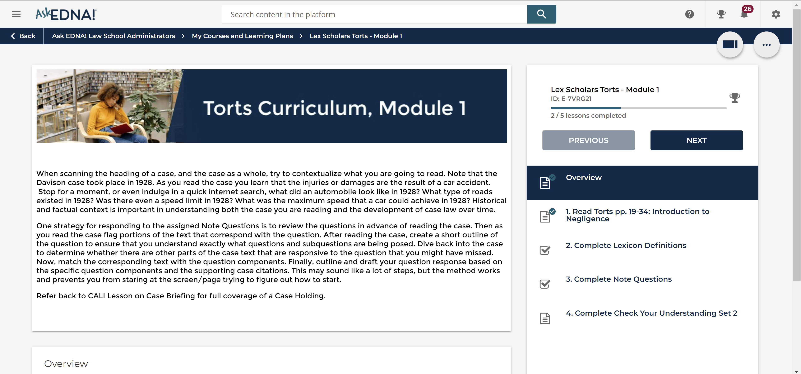
On-Line LMS Interface

Slide 16
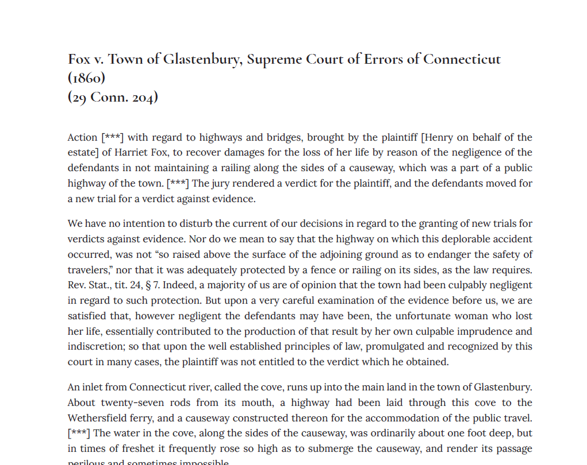
Skills Development: Understanding
Notes:
Note that Lexicon entries provide training on background knowledge (Historical/Contextual) as well as vocabulary knowledge (Legal Terms).
Example Lexicon Entries
Legal
Locus in Quao
Historical/Contextual
Causeway
Freshet

Slide 17
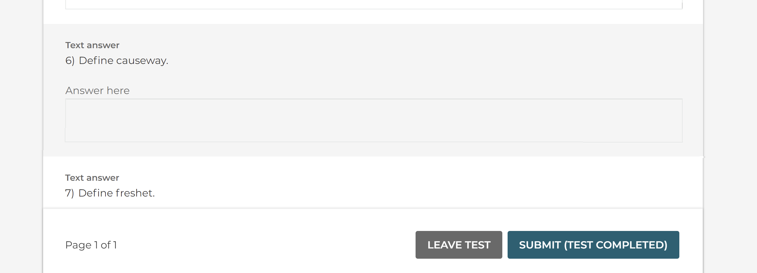
Skills Development: Understanding
Notes:
Note that Lexicon entries provide training on background knowledge (Historical/Contextual) as well as vocabulary knowledge (Legal Terms).
Example Lexicon Entries
Legal
Locus in Quao
Historical/Contextual
Causeway
Freshet

Slide 18
Skills Development: Understanding
Notes:
What is the holding in the case?
In laypersons terms, who “wins?” Why is this significant?
What does it tell you if someone is a petitioner versus a respondent? (or an appellant versus an appellee?)
On what does the court base its reasoning? Does it focus on the capacity or incapacity of engeineers to prevent the type of accident at issue here? Or does the court emphasize policy reasons. Does it follow precedentential Authority?

Slide 19
Skills Development: Understanding
Notes:
What is the holding in the case?
In laypersons terms, who “wins?” Why is this significant?
What does it tell you if someone is a petitioner versus a respondent? (or an appellant versus an appellee?)
On what does the court base its reasoning? Does it focus on the capacity or incapacity of engeineers to prevent the type of accident at issue here? Or does the court emphasize policy reasons. Does it follow precedentential Authority?

Slide 20
Skills Development: Understanding
Notes:
What is the holding in the case?
In laypersons terms, who “wins?” Why is this significant?
What does it tell you if someone is a petitioner versus a respondent? (or an appellant versus an appellee?)
On what does the court base its reasoning? Does it focus on the capacity or incapacity of engeineers to prevent the type of accident at issue here? Or does the court emphasize policy reasons. Does it follow precedentential Authority?

Slide 21
Skills Development: Interpreting
Notes:
Relating the steps of analysis will train students on the verbal reasoning used in legal writing.

Slide 22
Skills Development: Interpreting
Notes:
Relating the steps of analysis will train students on the verbal reasoning used in legal writing.

Slide 23
Skills Development: Interpreting
Notes:
Relating the steps of analysis will train students on the verbal reasoning used in legal writing.

Slide 24
Skills Development: Application
Notes:
H5P functions

Slide 25
Skills Development: Application

Slide 26
Skills Development: Application

Slide 27
Skills Development: Application

Slide 28
Measures of Engagement
Attending synchronous course sessions
Clicking on CALI Lessonlinks
Clicking on Casebook H5P links
Completing graded assessments

Slide 29
Measures of Performance
Scores on graded assessments sorted into skills areas of
Understanding,
Interpreting, and
Application

Slide 30
Thank You!
Please visit AccessLex.org

