Slide 1
“Evolution of a podcast – Talking Legal Ed”
Professor Billie Jo Kaufman with Professors Linda Jellum & David Ritchie
Technical Assistant – Timothy Spishock

Slide 2
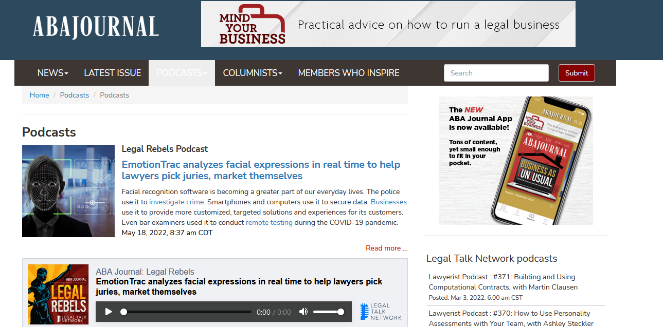
Why a podcast?
Popular Format – Widely used in the legal profession, legal education and beyond

Slide 3
Why the podcast format?
Great for commuters, at the gym or on a flight
Many kinds – professional, substantive specific, arts, history
Easily discoverable – “wherever you get your podcasts”
Audio format
Low-cost start-up; little support necessary
Microphone and headphones
Easily marketed and share on all social media & reshared

Slide 4
Others at Mercer University

Slide 5
“Talking Legal Ed”

Slide 6
Topics & Overall Theme
How law professors, law librarians, etc. integrate legal topics (generally “hot” topics) into their classes or curricular coverage

Slide 7
How we choose ?
Suggestions, FB posts, AALS posts of speakers at panels or symposia, people we know or have heard on panels, generally recognized scholars or good instructors
Sometimes a “hot topic” – then find a possible speaker

Slide 8
Process
We send a request with basic information about “Talking Legal Ed” to the “talent”; why we’re interested in hosting them for an episode, schedule a pre-interview, schedule the taping, follow-up edit work, and add to podcast site

Slide 9
Pre-Interview – Huge!!!
This piece of work helps us talk through the topic(s); focus the conversation; develop a list of possible questions for the interview and get to know the speaker so the podcast sounds like a conversation and less scripted. On occasion, this pre-interview changes the topic we intend to cover
Proves very valuable – this is a podcast – it is not a scripted presentation – we do correct with small edits, but nothing too major
We also learn a bit more about the topic so that we can expand our questions and add meaning to the exchange

Slide 10
Taping & Posting
Create a scheduled time; zoom links are sent to all involved
Begin taping
Use of chat
End taping
Introduction/Conclusion
Intakes/Outtakes
Final Editing
Posting

Slide 11
Technical Needs
Headphones – Contact me for links
Microphones – Contact me for links
Camera – we use logi that works with our Dell laptops
Most of us got our equipment via Amazon – low start-up costs

Slide 12
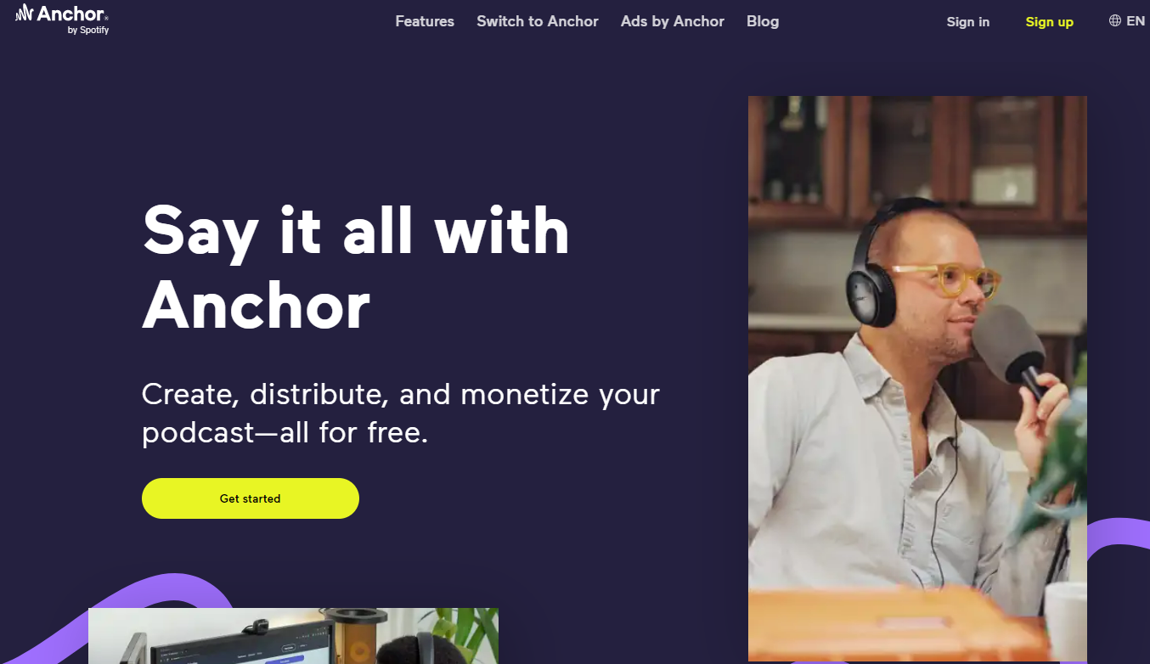
Technical Needs
“TALKING LEGAL ED” is housed on Anchor.fm (free hosting site) Anchor - The easiest way to make a podcast

Slide 13
Technical Needs
Other platforms

Slide 14
Technical Needs
Be careful with hosting services and what “free” includes
Make sure hosting service allows for easy links to upload to major distribution platforms (Apple, Spotify)
Editing – Audacity and Adobe Audition (creative cloud suite)
Intro/Outro Work – www.fiverr.com

Slide 15
Marketing – Name/Artwork Thanks to Kaylee Jellum

Slide 16
Posting
On all typical podcast outlets
We post on Facebook, ListServs, and repost
Our speakers post on their outlets – sometimes, their podcasts
Reposting

Slide 17
Talking Legal Ed

Slide 18
Challenges
Talent
Topics
Scheduling

Slide 19
Opportunities
Great conversations among colleagues
Gives voices to “hot topics” in another medium
Can use in classrooms conversations when appropriate
Can “repost” when the topic resurfaces
Collegial efforts – we all play an important role
Can involve others – faculty, deans, officers of organization, students

Slide 20
Questions ?
Linda Jellum jellum_l@law.mercer.edu
David Ritchie Ritchie_d@law.mercer.edu
Tim Spishock Spishock_t@law.mercer.edu (Attending CALI)
Billie Jo Kaufman Kaufman_b@law.mercer.edu

